Slide 1
Assembly Language and Machine language (part 2)
Jihene Kaabi & Youssef Harrath

Slide 2
Data Transfer Instructions

Slide 3
The mov instruction
The mov instruction, which requires two operands and has the syntax
mov destination,source
The data are copied from source to destination, and the source operand remains unchanged.
Both operands should be of the same size.

Slide 4
The mov instruction (cont.)
The mov instruction can take one of the following five forms:
There is no move instruction to transfer data from memory to memory, as the Pentium does not allow it.
mov Form | Restrictions
mov register, register | Destination register cannot be CS or (E)IP registers. Both registers cannot be segment registers.
mov register, immediate | Register cannot be a segment register.
mov memory, immediate
mov register, memory
mov memory, register

Slide 5
Arithmetic Instructions
The Pentium provides several instructions to perform simple arithmetic operations.
we will describe five instructions to perform addition, subtraction, and comparison.
Arithmetic instructions update the status flags, to record the result of the operation.

Slide 6
Increment/Decrement Instructions
These instructions can be used to either increment or decrement the operands.
The inc (increment) instruction adds one to its operand.
The dec (decrement) instruction subtracts one from its operand.
Both instructions take a single operand. The operand can be either in a register or in memory.
e.g., inc ECX ; ECX++

Slide 7
ADD Instructions
The add instruction can be used to add two 8-, 16-, or 32-bit operands.
The syntax is add destination, source
As with the mov instruction, add can also take the five basic forms depending on how the two operands are specified.
The semantics of the add instruction are destination = destination + source
As a result, destination loses its contents before the execution of add but the contents of source remain unchanged.

Slide 8
Subtract Instructions
The sub (subtract) instruction can be used to subtract two 8-, 16-, or 32-bit numbers.
The syntax is sub destination, source
The source operand is subtracted from the destination operand and the result is placed in the destination.
destination = destination - source

Slide 9
Compare Instruction
The cmp (compare) instruction is used to compare two operands (equal, not equal, and so on).
cmp destination, source
Subtracts the source operand from the destination operand but does not alter any of the two operands, as shown below: destination – source
The flags are updated as if the sub operation were performed.
The main purpose of the cmp instruction is to update the flags so that a subsequent conditional jump instruction can test these flags.

Slide 10
Directives
A directive is an artifact of the assembler not the CPU.
They are generally used to either instruct the assembler to do something or inform the assembler of something.
They are not translated into machine code.
Common uses of directives are:
define constants
define memory to store data into group memory into segments
conditionally include source code
include other files

Slide 11
Directives (cont.)
NASM (Netwide Assembler) code passes through a preprocessor just like C.
It has many of the same preprocessor commands as C.
However, NASM's preprocessor directives start with a % instead of a # as in C.

Slide 12
The EQU Directive
The EQU directive can be used to define a symbol.
Symbols are named constants that can be used in the assembly program.
The format is: symbol EQU value
Symbol values can not be redefined later.
E.g. Num_Of_Students EQU 90
mov AX, Num_Of_Students

Slide 13
The %define Directive
This directive is like C's #define directive. It is most used to define constant macros just as in C.
%define SIZE 100
mov eax, SIZE
The above code defines a macro named SIZE and shows its use in a MOV instruction.
Macros are more flexible than symbols in two ways.
Macros can be redefined and can be more than simple constant numbers.

Slide 14
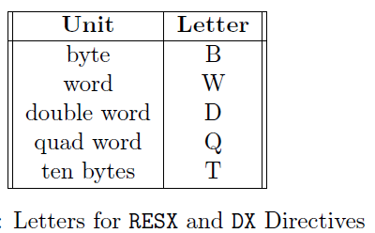
The Data Directive (1/4)
Data directives are used in data segments to define room for memory.
There are two ways memory can be reserved.
The first way only defines room for data;
The second way defines room and an initial value.
The first method uses one of the RESX (Reserve Memory) directives. The X is replaced with a letter that determines the size of the object (or objects) that will be stored.

Slide 15
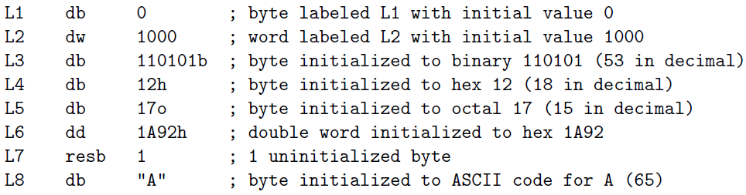
The Data Directive (2/4)
The second method (that defines an initial value, too) uses one of the DX directives. The X letters are the same as those in the RESX directives.
It is very common to mark memory locations with labels. Labels allow one to easily refer to memory locations in code. Below are several examples:

Slide 16
The Data Directive (3/4)
Double quotes and single quotes are treated the same.
Consecutive data definitions are stored sequentially in memory.
That is, the word L2 is stored immediately after L1 in memory.

Slide 17
The Data Directive (4/4)
The DD directive can be used to define both integer and single precision floating point constants.
However, the DQ (Define Quad word) can only be used to define double precision floating point constants.
For large sequences, NASM's TIMES directive is often useful. This directive repeats its operand a specified number of times.
E.g.,
L12 times 100 db 0 ; equivalent to 100 (db 0)'s
L13 resw 100 ; reserves room for 100 words

Slide 18
The Data Directive: Labels
Labels can be used to refer to data in code.
There are two ways that a label can be used.
If a plain label is used, it is interpreted as the address (or offset) of the data.
If the label is placed inside square brackets ([ ]), it is interpreted as the data at the address.
In other words, one should think of a label as a pointer to the data and the square brackets dereferences the pointer just as the asterisk does in C.
In 32-bit mode, addresses are 32-bit.

Slide 19
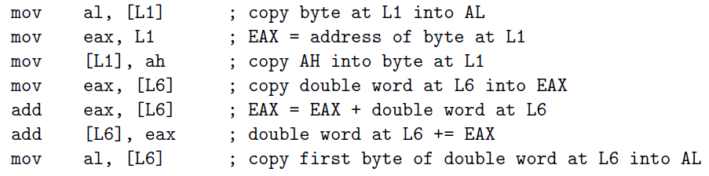
Labels : Examples
Labels can be used to refer to data in code.
An important property of NASM is that the assembler does not keep track of the type of data that a label refers to.
It is up to the programmer to make sure that he (or she) uses a label correctly.
Later it will be common to store addresses of data in registers and use the register like a pointer variable in C.

Slide 20
Labels : Examples (cont.)
Again, no checking is made that a pointer is used correctly. In this way, assembly is much more error prone than even C.
Consider the following instruction:
mov [L6], 1 ; store a 1 at L6
This statement produces an operation size not specified error. Why?
Because the assembler does not know whether to store the 1 as a byte, word or double word.
To fix this, add a size specifier:
mov dword [L6], 1 ; store a 1 at L6
This tells the assembler to store a 1 at the double word that starts at L6.
Other size specifiers are: BYTE, WORD, QWORD and TWORD (defines a ten byte area of memory).

Slide 21
Input and Output
Input and output are very system dependent activities. It involves interfacing with the system's hardware.
High level languages, like C, provide standard libraries of routines that provide a simple, uniform programming interface for I/O.
Assembly languages provide no standard libraries.
They must either directly access hardware (which is a privileged operation in protected mode) or use whatever low-level routines that the operating system provides.

Slide 22
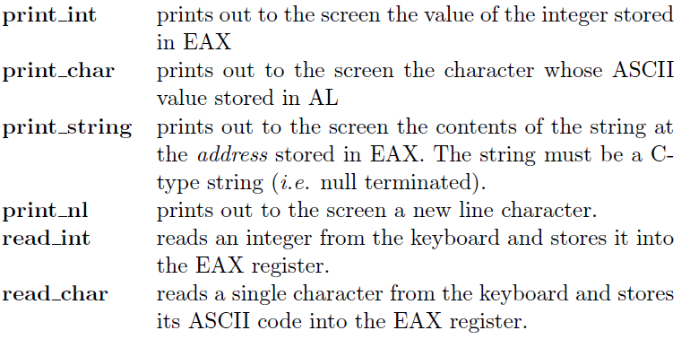
Input and Output Routines

Slide 23
Print Routines
To use one of the print routines, you must load EAX with the correct value and uses a CALL instruction to invoke it.
The CALL instruction is equivalent to a function call in a high-level language. It jumps execution to another section of code but returns to its origin after the routine is over.
E.g., mov eax, 123
call print_int
call print_nl

Slide 24
Debugging Routines
Debugging routines display information about the state of the computer without modifying the state.
These routines are really macros that preserve the current state of the CPU and then make a subroutine call.
Macros are used like ordinary instructions. Operands of macros are separated by commas.
There are four debugging routines named dump regs, dump mem, dump stack, and dump math; they display the values of registers, memory, stack and the math coprocessor, respectively.

Slide 25
dump_regs macro
This macro prints out the values of the registers (in hexadecimal) of the computer to stdout (i.e. the screen).
It takes a single integer argument that is printed out as well.
This can be used to distinguish the output of different dump regs commands.
dump_regs 1 ; print out the values of the registers

Slide 26
dump_mem macro
This macro prints out the values of a region of memory (in hexadecimal) and also as ASCII characters.
It takes three comma delimited arguments.
The first is an integer that is used to label the output (just as dump regs argument).
The second argument is the address to display. (This can be a label.)
The last argument is the number of 16-byte paragraphs to display after the address.
The memory displayed will start on the first paragraph boundary before the requested address.
dump_mem 1 , msg, 1 ; print out the memory

Slide 27
dump_stack macro
This macro prints out the values on the CPU stack. (The stack will be covered in Chapter 4.)
The stack is organized as double words, and this routine displays them this way.
It takes three comma delimited arguments.
The first is an integer label (like dump regs).
The second is the number of double words to display below the address that the EBP register holds.
The third argument is the number of double words to display above the address in EBP.
dump_stack 3 , 8, 8 ; print out the stack

Slide 28
Dump_math macro
This macro prints out the values of the registers of the math coprocessor.
It takes a single integer argument that is used to label the output just as the argument of dump regs does.
dump_math 1 ; print out the registers of the math coprocessor

Slide 29
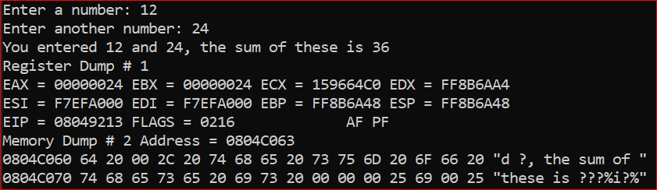
Exercise
Write an assembly program that
prompts the user to enter two numbers,
prints a message to show to the user the entered numbers,
calculate the difference between the two entered numbers,
prints the results to the screen, and
prints the values of the registers and the memory.
The output should look like:

